Slide 1

UEC1811-PROJECT WORK
An Hybrid Deep Learning Model for Fault Diagnosis in
Gear Boxes through Vibration Analysis
DOMAIN – SIGNAL PROCESSING
GUIDED BY
Dr.S.Stephe M.E.,Ph.D.,
Assistant Professor
ECE/KRCE
TEAM MEMBERS
R.Sanjay Kumar (8115U20EC084)
M.Sivagnanam (8115U20EC099)
M.Srihari Prasath (8115U20EC103)
P.Yogaraj (8115U20EC116)

Slide 2
CONTENTS
ABSTRACT
INTRODUCTION
APPLICATIONS
LITERATURE REVIEW
RESULTS FROM EXISTING SYSTEM
CHALLENGES IN EXISTING SYSTEM
METHODOLOGY
RESULTS
CONCLUSION

Slide 3
ABSTRACT
Gearbox fault diagnosis is essential for maintaining machinery reliability, with vibration signals serving as primary diagnostic indicators. This paper provides an overview of recent advancements in vibration-based condition monitoring, focusing on gearbox fault diagnosis.
Drawing from reputable databases like Web of Science and Scopus, we explore a deep learning techniques tailored for this purpose. Our study encompasses preprocessing, visualization, and classification of vibration signals to differentiate between healthy and faulty gearboxes.
Leveraging a hybrid approach including CNN, LSTM and we present a robust framework for gearbox fault diagnosis. Additionally, we discuss future research directions such as graph-based neural networks and transformer convolutional networks to further enhance diagnostic accuracy. This paper aims to serve as a comprehensive guide for researchers and practitioners in the field of gearbox fault diagnosis using vibration analysis, integrating both deep learning methodology.

Slide 4
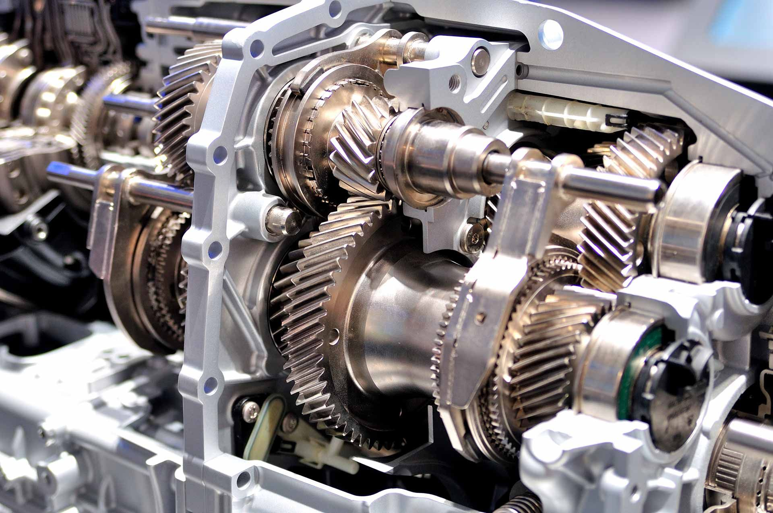
INTRODUCTION
Monitoring machine health is crucial for industries. Vibration signals help us catch faults early, reducing costs and preventing accidents. When machines work at different speeds, understanding the vibrations becomes tricky. We usually get speed info from extra sensors or by analyzing vibrations with accelerometers.
Our focus? Using deep learning for fault detection using only vibration signals—no extra sensors. Think of it like training a smart system to recognize normal vibrations and spot anything off. We've got datasets with healthy and faulty vibes, aiming to make this tech sharper for better machine health checks.

Slide 5
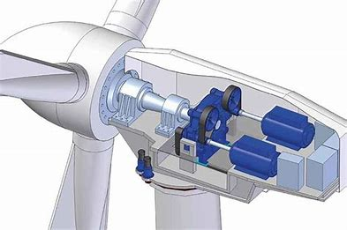
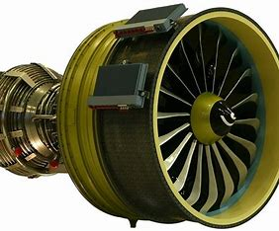
APPLICATIONS
Vehicle Health Monitoring
Aircraft Propulsion Systems
Wind Turbines
Ship Propulsion Systems
Electric Power Plants
Train Transmission Systems
Heavy Machinery in Mining

Slide 6
LITERATURE REVIEW
S.no | Title | Author & Published year | Description
1. | Recent advances in the application of deep learning for fault diagnosis of rotating machinery using vibration signals | Bayu Adhi Tama, Malinda Vania (2022) | Obtaining rotating speed signals, essential for fault diagnosis, can be challenging. Two main approaches exist: placing extra speed sensors or collecting speed from vibration signals using accelerometers..
2. | Probabilistic Gear Fault Diagnosis Using Bayesian Convolutional Neural Network | Kai Zhou, Jiong Tang (2022) | This study proposes a Bayesian convolutional neural network (BCNN) for robust gear fault diagnosis, mitigating uncertainties in vibration-based methods.
3. | Condition monitoring and fault diagnosis of motor bearings using undersampled vibration signals from a wireless sensor network | Xiaoxian Wang, Siliang Lu (2017) | This study investigates a new method for motor bearings condition monitoring and fault diagnosis using the undersampled vibration signals acquired from a WSN

Slide 7
RESULTS FROM THE EXISTING SYSTEM
AUTHOR REF | DATASET | ALGORITHM | TEST ACCURACY
Wang et al. (2020) | PU (Lessmeier et al. (2016) and private | SVM | 48%
Liu et al. (2017) | PHM 2009 and Private | KNN | 67%
Kai Zhou, Jiong Tang (2022) | CWRU | BCNN | 89%
Xiaoxian Wang, Siliang Lu (2017) | XJTU-SY Bearing | RNN | 87%
Bayu Adhi Tama, Malinda Vania (2022) | ABLT-1A Bearing | MLP | 92%

Slide 8
CHALLENGES IN EXISTING SYSTEM
Less accuracy due to ML algorithm such as SVM, Decision Tree,…
Predictions may get affected due to the reduction in the accuracy.
Real time Challenges:-
Noise & Interference
Data Volume & Complexity
OBJECTIVE:
To overcome all the above drawbacks, a multi model recognition network is designed using DL algorithms.

Slide 9
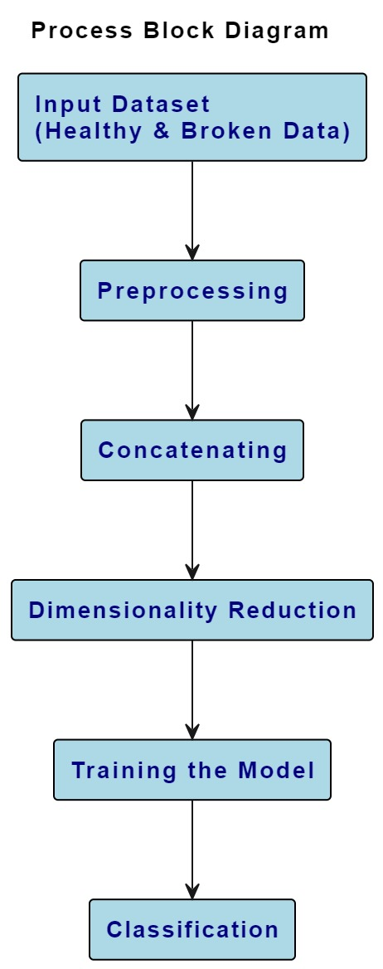
METHODOLOGY

Slide 10


Software Required:-
Visual Studio Code
Jupyter Notebook

Slide 11
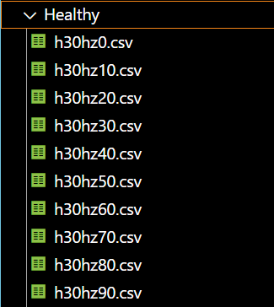
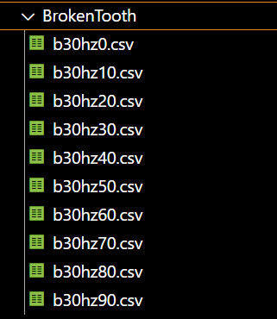
DATASET(WIND TURBINE) Online Dataset: https://www.kaggle.com/datasets/brjapon/gearbox-fault-diagnosis
Healthy:- | Broken Tooth:-

Slide 12
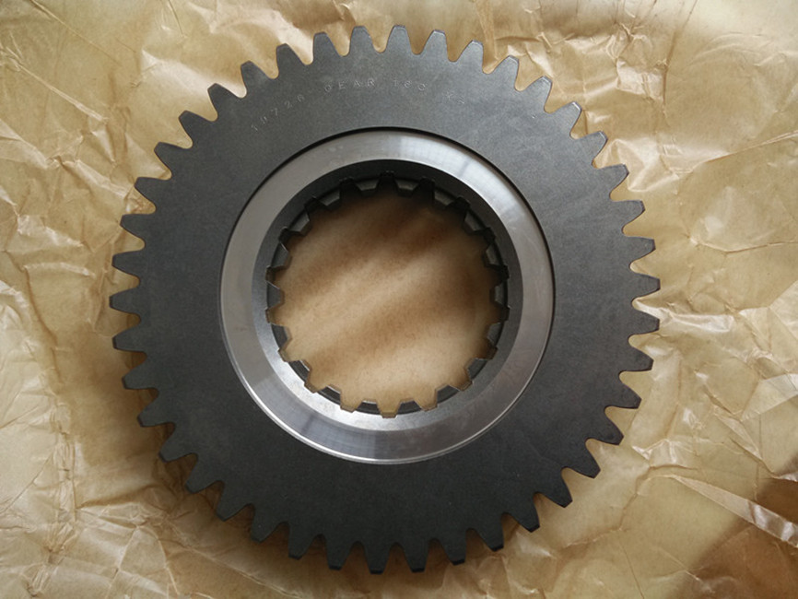
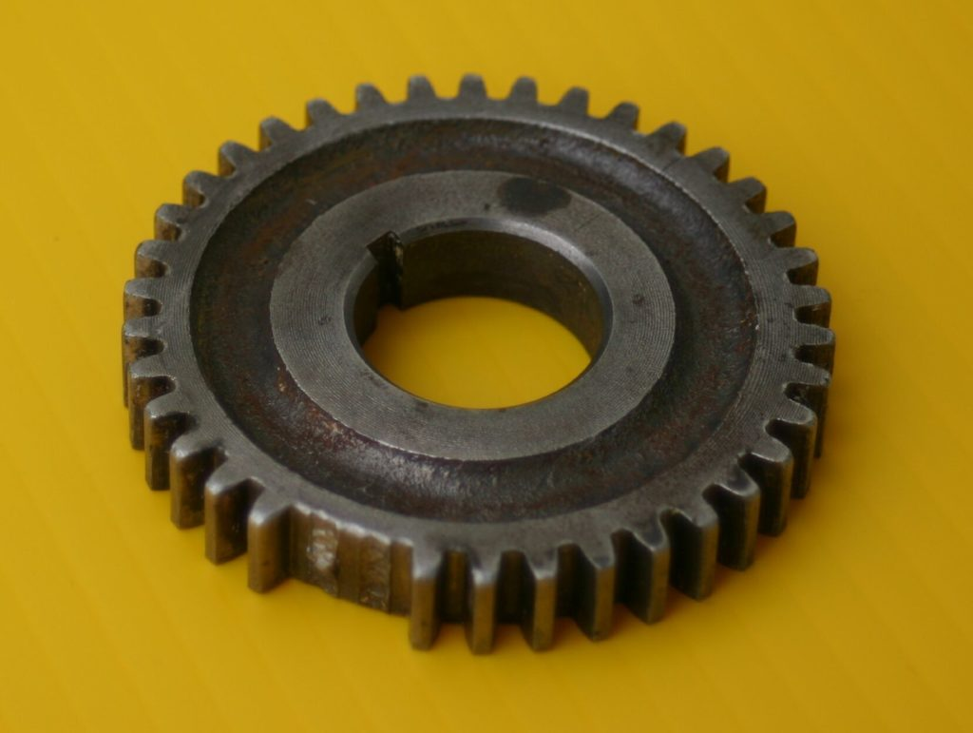
Healthy Condition:- | Broken Condition:-

Slide 13
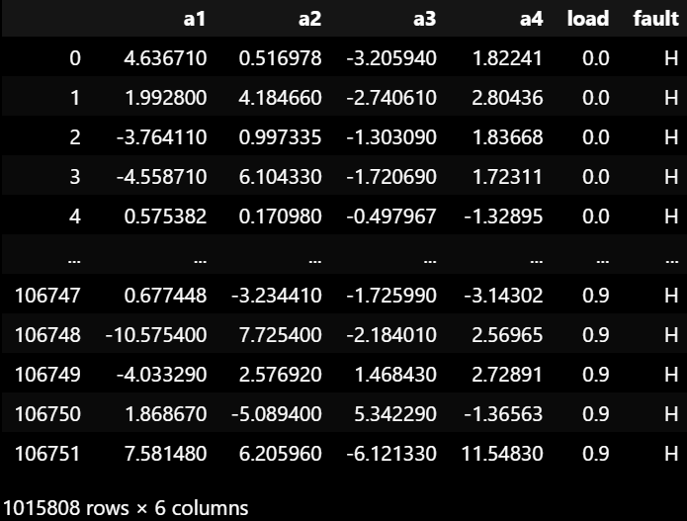
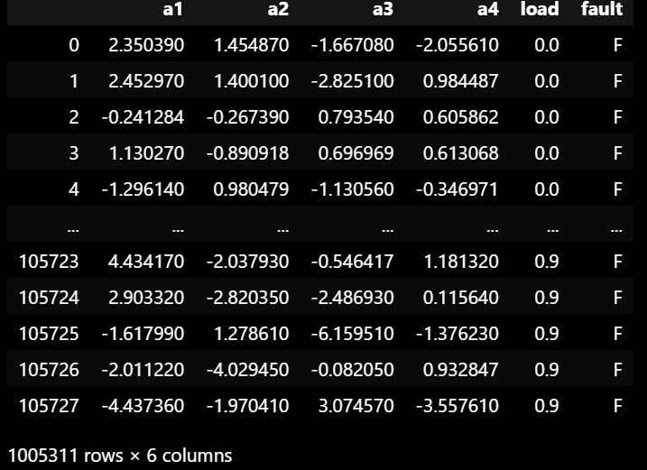
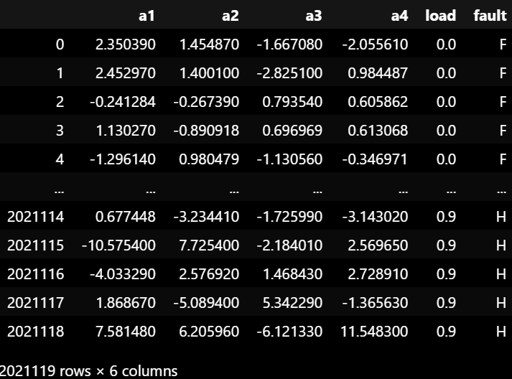
Data Concatenation
Healthy:- After Concatenating:- | Broken Tooth:-

Slide 14
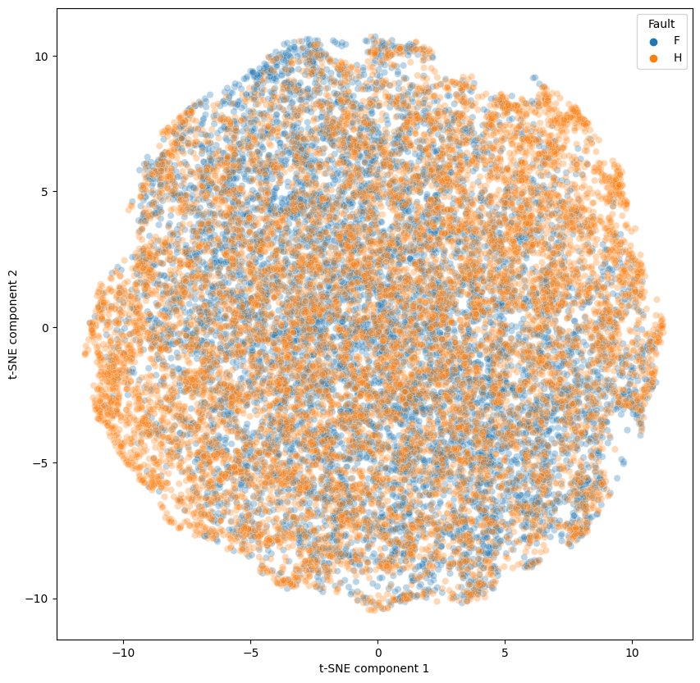
T-SNE Dimensionality Reduction

Slide 15
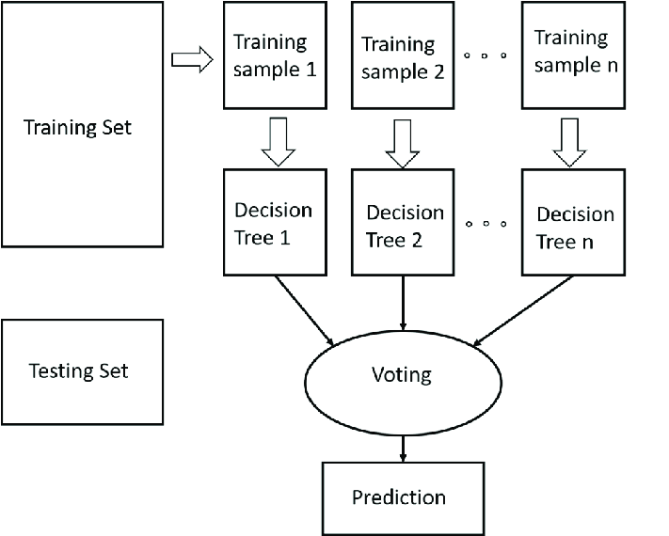
RANDOM FOREST TREE
Definition:
Ensemble learning method using multiple decision trees.
Key Features:
Randomization
Mode Output
Usage in Gear Fault Diagnosis:
Feature Importance
Robust
Interpretability

Slide 16
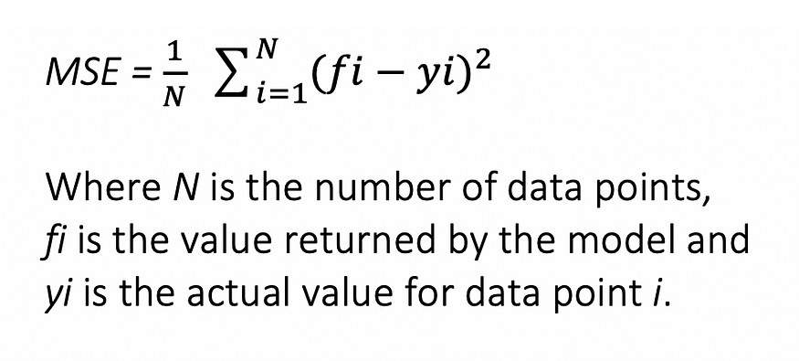
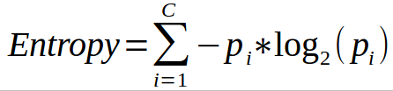
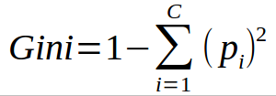
Equations For Random Forest Algorithm :
Regression :
Entropy :
Classification :
Here, pi represents the relative frequency of the class you are observing in the dataset and c represents the number of classes.

Slide 17
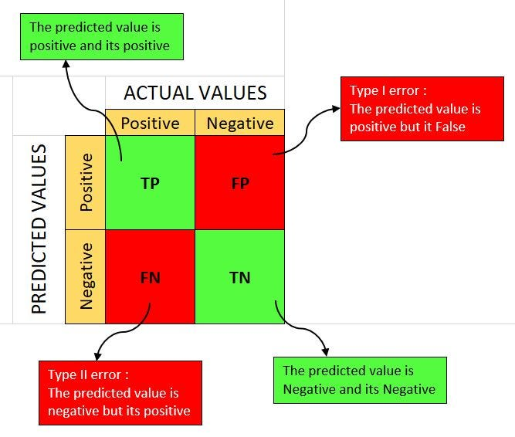
Confusion Matrix

Slide 18
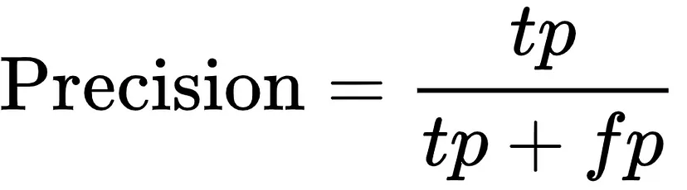
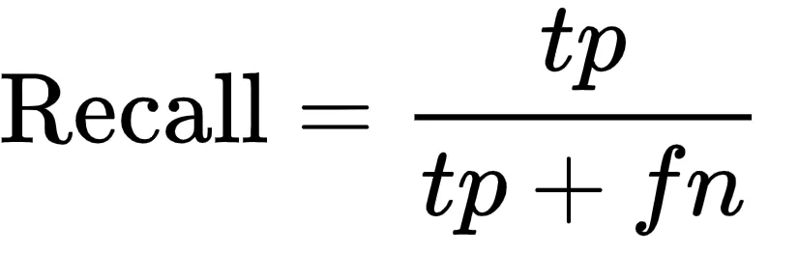
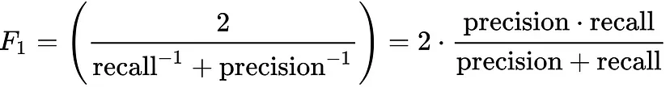
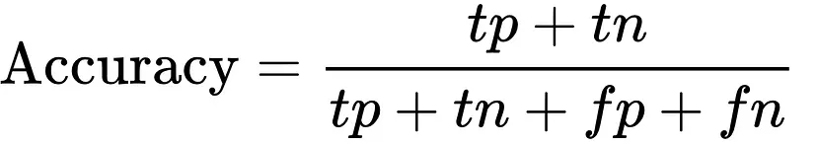
Classification Report Values

Slide 19
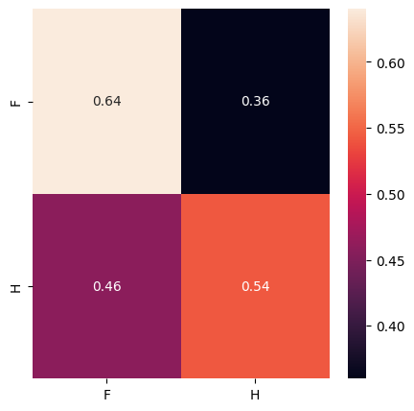
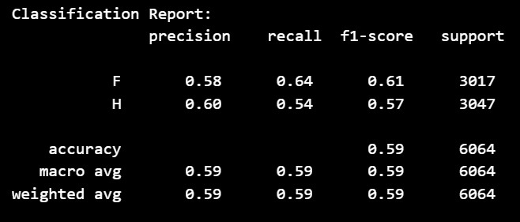
Confusion Matrix & Classification report
Confusion_matrix:- | Classification_report:-

Slide 20
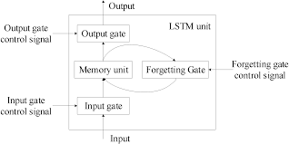
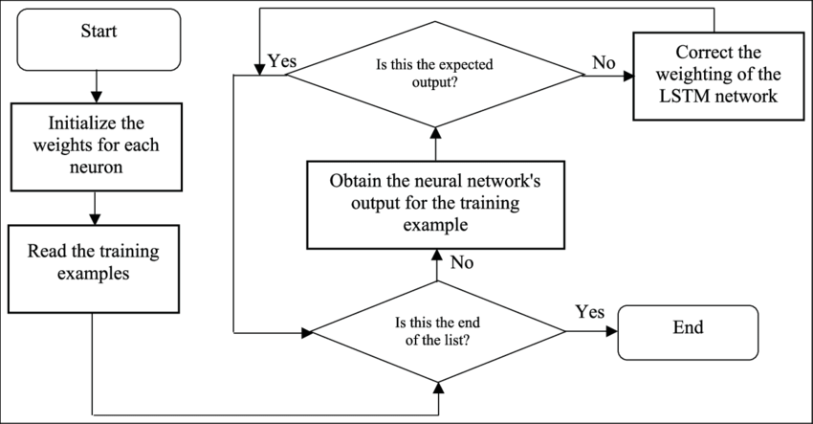
Long Short-Term Memory (LSTM)
Definition:
Recurrent neural network (RNN) architecture designed for processing sequential data with long-range dependencies.
Key Features:
Memory Cells
Forget Gate
input and output Gates
Usage in Gear Fault Diagnosis:
Temporal Dependency Modeling
Long-Term Dependency Handling
Robustness:

Slide 21
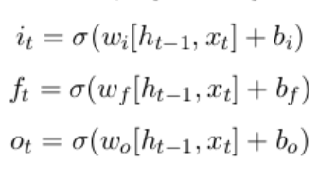
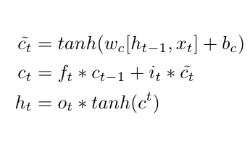
Equations For LSTM :
The equations for the gates in LSTM are:
The equations for the cell state, candidate cell state and the final output:

Slide 22
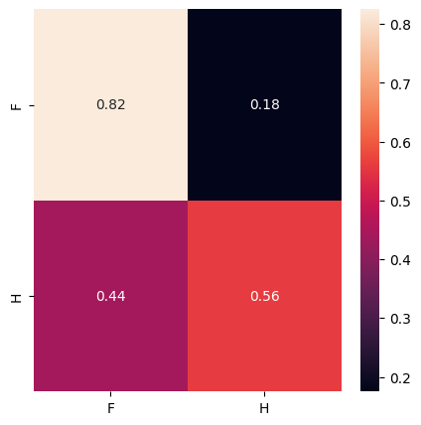
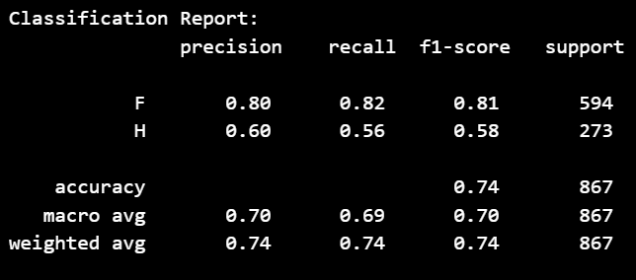
Confusion Matrix & Classification Report

Slide 23
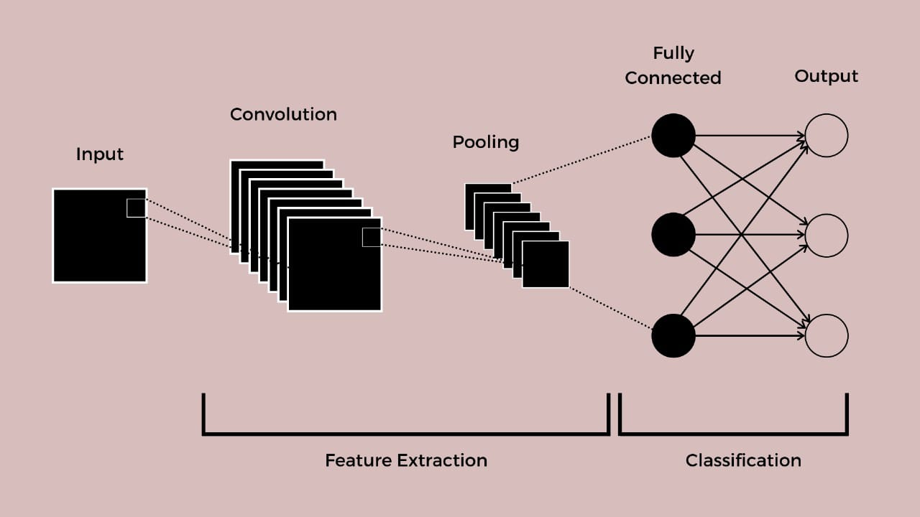
Convolutional Neural Network (CNN)

Slide 24
Convolutional Neural Network (CNN)
Definition:
Convolutional neural network (CNN) architecture designed for processing image data with hierarchical feature extraction.
Key Features:
Convolutional Layers
Pooling Layers
Activation Functions
Fully Connected Layers
Usage in Image Recognition:
Hierarchical Feature Extraction
Spatial Invariance
Robustness to Variations

Slide 25
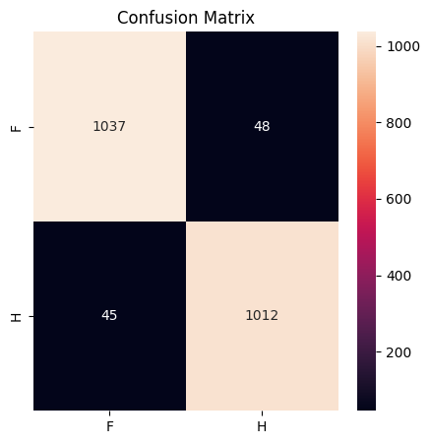
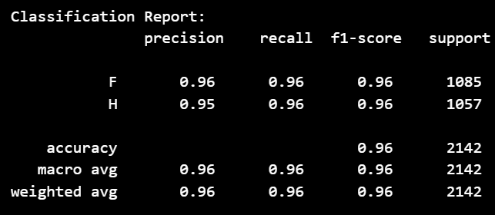
Confusion Matrix & Classification Report

Slide 26
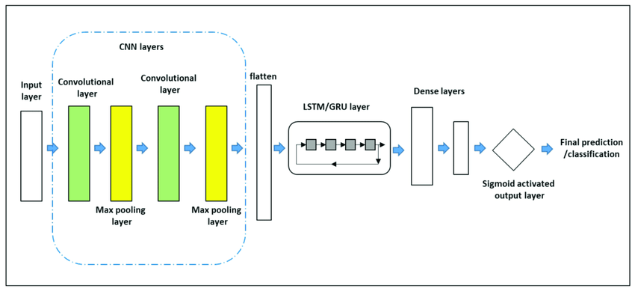
Hybrid CNN - LSTM

Slide 27
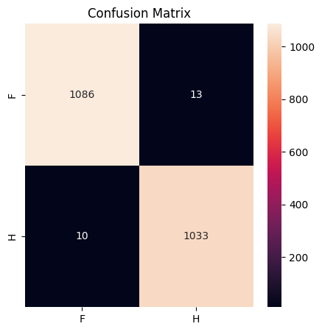
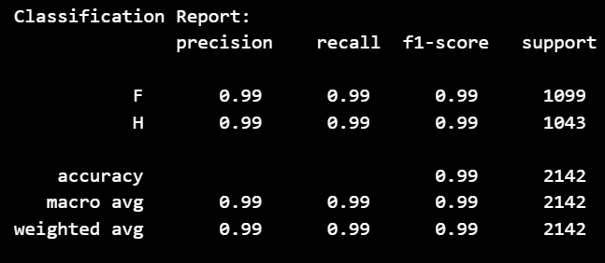
Confusion Matrix & Classification Report

Slide 28
Results
Algorithms | Accuracy
Random Forest Tree | 59%
Long Short Term Memory (LSTM) | 74%
Convolutional Neural Network (CNN) | 96%
Hybrid CNN - LSTM | 99%

Slide 29
CONCLUSION
Our project focuses on diagnosing gear faults in industrial machinery using machine learning techniques. We start with data preprocessing, including noise removal, normalization, and feature extraction from vibration signals. Visualization helps us understand the distribution of healthy and faulty samples.
We employ Random Forest, CNN, and LSTM for classifying the vibration signals. Random Forest uses multiple decision trees, CNN processes grid-like data, and LSTM captures temporal dependencies. These models help in accurate fault diagnosis, improving machinery maintenance efficiency and reliability.
Our approach includes model interpretability through feature visualization and coarse localization maps, ensuring we understand the reasoning behind predictions. We also incorporate domain knowledge and physics-informed learning techniques to enhance model robustness.

Slide 30


